Slide 1


COM EXE Servers
COM Programming
Notes:
Page <number>
WNCOMPG-2 v1.5
Chapter 11, COM EXE Servers

Slide 2


Chapter Overview
Objectives
  Explain the need for marshalling when crossing the process boundary
  Examine a COM EXE server
Chapter content
  Proxies and stubs
  Standard marshaling
  Type-library marshalling
  Marshalling issues and IDL
  EXE servers
  Accessing a server remotely
Practical content
  Build a simple EXE server
Summary
Notes:
Page <number>
WNCOMPG-2 v1.5
Chapter 11, COM EXE Servers

Slide 3


Pros and Cons of an EXE Server
Advantages
  Fault tolerance: EXE server runs in its own address space
  Security: Services can be run with a known security ID
Disadvantages
  Performance: Data has to be transmitted between processes
Notes:
Page <number>
WNCOMPG-2 v1.5
Chapter 11, COM EXE Servers

Slide 4

Crossing the Process Boundary
COM object can reside in another process
On the client side, a proxy is responsible for representing the server object
On the server side, a stub is responsible for delivering a call to the object
Client
Apparent call
Server
Actual call
Upcall
100110111100011110010101100001011000100
Proxy
Stub
Binary encoded form of the call is given to system for delivery
Notes:
Page <number>
WNCOMPG-2 v1.5
Chapter 11, COM EXE Servers

Slide 5
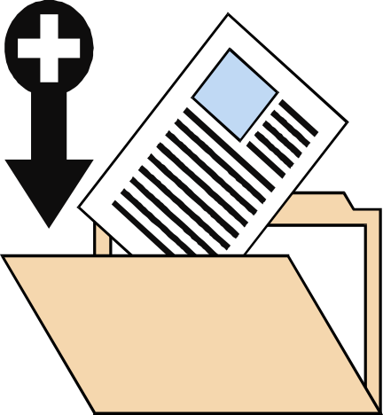
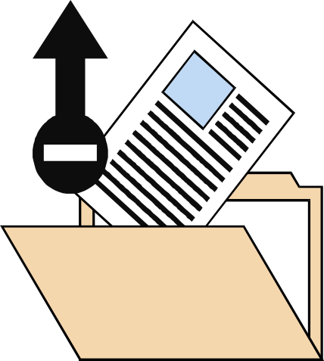
Marshalling
Marshalling is the translation of call parameters into an intermediate binary representation for transmission
Un-marshalling is the translation back from the on-the-wire representation to call parameters
Marshal
Send
Un-marshal
Notes:
Page <number>
WNCOMPG-2 v1.5
Chapter 11, COM EXE Servers

Slide 6


Using Standard Marshalling
Define object interface(s) in IDL
Compile using MIDL compiler
  Generates proxy/stub DLL source code
Compile and link proxy/stub DLL
  Define REGISTER_PROXY_DLL
Register this DLL under HKCR\Interface\<IID>
  Call DllRegisterServer() on the proxy/stub DLL,
  e.g. using regsvr32.exe
XXX.idl
MIDL
compiler
Interface proxy file: contains proxy and stub code for interfaces in IDL file
XXX_p.c
Proxy DLL file: contains code
required to put proxy and stub
code into a DLL (e.g. DllMain)
dlldata.c
Notes:
Page <number>
WNCOMPG-2 v1.5
Chapter 11, COM EXE Servers

Slide 7
Using Type-Library Marshalling
Define interface in IDL
  Must use Automation-compatible types
  Tag with [oleautomation] or [dual] attribute
Generate type library using MIDL compiler
Register type library
  Under HKCR\TypeLib\<LIBID>\1.0\0\Win32
Associate type library with interface
  LIBID under HKCR\Interface\<IID>\TypeLib
Set proxy/stub DLL for interface
  Set HKCR\Interface\IID\ProxyStubClsid32 to
  [00020424-0000-0000-C0000-000000000046]
  This GUID corresponds to the PSOAInterface class, which points to oleaut32.DLL
No need to install MIDL-generated proxy/stub DLL
Notes:
Page <number>
WNCOMPG-2 v1.5
Chapter 11, COM EXE Servers

Slide 8
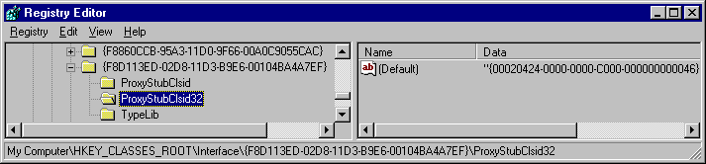
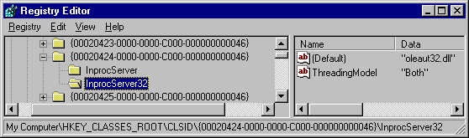
Registering a Proxy/Stub DLL
COM locates the interface proxy/stub DLL via the HKCR/Interface/<IID> registry key
  Will contain a ProxyStubClsid32 entry
This interface uses the type-library marshaller, which is implemented in the OLE Automation DLL
Notes:
Page <number>
WNCOMPG-2 v1.5
Chapter 11, COM EXE Servers

Slide 9
Marshalling Issues and IDL
Ensure data is passed in most efficient manner
  Use [in] and [out] attributes *
Only support NULL and alias pointers where necessary
  Be aware of the [pointer_default()] attribute
Support varying length strings
  Marshaller needs to know how much data to copy
  Use [string] attribute or BSTRs *
Support varying size arrays
  Marshaller needs to know how much data to copy
  Use [size_is] and [length_is] attributes
Support interface pointers
  Use [iid_is] attribute
* See Introduction to IDL chapter
Notes:
Page <number>
WNCOMPG-2 v1.5
Chapter 11, COM EXE Servers

Slide 10
Pointer Types and pointer_default()
pointer_default() for use with embedded pointers
Pointer Type
Reference
Unique
Full
IDL attribute
ref
unique
ptr
Allows NULL pointers
No
Yes
Yes
Allows alias pointers
No
No
Yes
// SimpleAccount.idl ----------------
import "unknwn.idl";
[
object, uuid(7902EAB1-E763-11d2-9C56-000000000000),
pointer_default(unique)
]
interface IAccount : IUnknown
{
HRESULT GetBalance([out, retval] float *pBalance);
...
};
Notes:
Page <number>
WNCOMPG-2 v1.5
Chapter 11, COM EXE Servers

Slide 11
Arrays
If array size is fixed at design time, specify its length
Otherwise, use [size_is] attribute
  Specifies maximum capacity of array
With out parameters, also use [length_is] attribute
  Specifies valid length of array
short rgs[7] = {8, 13, 27, 34, 35, 41, 24};
HRESULT SetNumbers([in] short rgs[7]);
HRESULT SetNumbers2([in] long cMax,
[in, size_is(cMax)] short *rgs);
HRESULT GetWinningNumbers([in] long cMax,
[out] long *pcActual,
[out, size_is(cMax),
length_is(*pcActual)] short *rgs);
Notes:
Page <number>
WNCOMPG-2 v1.5
Chapter 11, COM EXE Servers

Slide 12
Memory Management
An [out] parameter must be a pointer
  Server should allocate memory, and client should free it
What if client and server are in separate processes?
  Use COM task (memory) allocator
IBook.idl
HRESULT GetTitle([out, string] wchar_t* szOut);
HRESULT CBook::GetTitle(wchar_t** pszOut) {
wchar_t* szTitle = "How Steve Case Beat Bill Gates, Nailed the Netheads, and Made Millions in the War for the Web";
*pszOut = (wchar_t*)
CoTaskMemAlloc((wcslen(szTitle)+1)*sizeof(wchar_t));
wscpy(*pszOut, szTitle);
return S_OK;
}
Server-side implementation
wchar_t* szTitle = 0;
pBook->GetTitle(&szTitle);
wprintf(L"Book title: %s\n", szTitle;
CoTaskMemFree(szTitle);
Client-side code
Notes:
Page <number>
WNCOMPG-2 v1.5
Chapter 11, COM EXE Servers

Slide 13
Interface Pointers
void ** pointers are not allowed, e.g.
  ... is invalid, because MIDL compiler is unable to generate
  an appropriate proxy/stub
Use [iid_is] attribute to specify pointer's IID, e.g.
HRESULT GetInterface([out] void** ppvObject);
HRESULT GetInterface([in] REFIID riid, [out],
[iid_is(riid)] void **ppvObject);
Notes:
Page <number>
WNCOMPG-2 v1.5
Chapter 11, COM EXE Servers

Slide 14
EXE Servers
No changes required to component class
Some changes required to class factory
Server must call CoInitialize() and
CoUninitialize() for itself
Server cannot export any functions such as DllGetClassObject(), etc.
Server must manage its own lifetime
Notes:
Page <number>
WNCOMPG-2 v1.5
Chapter 11, COM EXE Servers

Slide 15
Differences from DLL Server
DLL Server Function
EXE Server Equivalent
DllGetClassObject()
On initialisation, server must register an instance of each of its class factories by calling CoRegisterClassObject(). Conversely, on termination, server must unregister each of its class factories by calling CoRevokeClassObject().
DllCanUnloadNow()
Server must terminate itself when global lock count decrements to zero. Otherwise, server must keep itself alive.
DllRegisterServer()
Server must register itself when command line parameter is
-RegServer
DllUnregisterServer()
Server must unregister itself when command line parameter is -UnRegServer
Notes:
Page <number>
WNCOMPG-2 v1.5
Chapter 11, COM EXE Servers

Slide 16
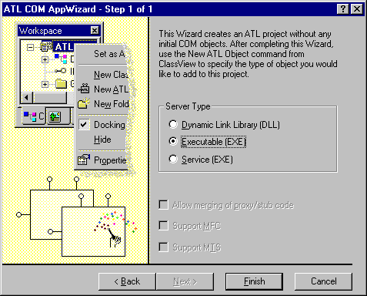
Building an EXE Server Using ATL
In Visual Studio , create new ATL COM APP Wizard project
  Select Executable (EXE) Server Type, then click Finish
  Wizard generates skeleton IDL, C++ source and header files
Notes:
Page <number>
WNCOMPG-2 v1.5
Chapter 11, COM EXE Servers

Slide 17
EXE Source File
Declares a global CExeModule object called _Module
  Extends functionality of CComModule to provide lifetime management
// SimpleAccount.cpp : Implementation of WinMain
#include "stdafx.h"
...
CExeModule _Module;
...
// stdafx.h : include file ...
...
class CExeModule : public CComModule {
public:
LONG Unlock();
HANDLE hEventShutdown;
void MonitorShutdown();
bool StartMonitor();
...
};
Notes:
Page <number>
WNCOMPG-2 v1.5
Chapter 11, COM EXE Servers

Slide 18
Lifetime Management
// SimpleAccount.cpp (continued)
StartMonitor() {
hShutdown = CreateEvent(NULL, false, false, false);
CreateThread(NULL, 0, MonitorProc, this, 0, &dwThreadID);
}
LONG CExeModule::Unlock() {
LONG l = CComModule::Unlock();
if (l == 0) SetEvent(hEventShutdown);
return l;
}
void CExeModule::MonitorShutdown() {
while (1) {
WaitForSingleObject(hEventShutdown, INFINITE);
// timeout code deleted for clarity
...
PostThreadMessage(dwThreadID, WM_QUIT, 0, 0);
}
}
static DWORD MonitorProc(void *pv) {
CExeModule *p = (CExeModule *)pv;
p->MonitorShutdown();
}
Creates Event "semaphore"
Returns object lock-count
Post WM_QUIT message to server's message queue
Thread procedure
Notes:
Page <number>
WNCOMPG-2 v1.5
Chapter 11, COM EXE Servers

Slide 19
Main Code
// SimpleAccount.cpp (continued)
extern "C" int WINAPI _tWinMain(HINSTANCE hInstance,
HINSTANCE *hPrevInstance, LPTSTR lpCmdLine, int nShowCmd)
{
CoInitialize( 0 );
_Module.Init(ObjectMap, hInstance, &LIBID_SIMPLEACCOUNTLib);
// server registration code removed for clarity
...
_Module.StartMonitor();
_Module.RegisterClassObjects(CLSCTX_LOCAL_SERVER,
REGCLS_MULTIPLEUSE);
while( GetMessage(&msg, 0, 0, 0) )
DispatchMessage(&msg);
_Module.RevokeClassObjects();
_Module.Term();
CoUninitialize();
return 0;
}
Starts background thread to monitor shutdown
Registers class factory
Returns FALSE when WM_QUIT message retrieved
Unregisters class factory
Notes:
Page <number>
WNCOMPG-2 v1.5
Chapter 11, COM EXE Servers

Slide 20
Registration Code
// SimpleAccount.cpp (simplified for clarity)
extern "C" int WINAPI _tWinMain(HINSTANCE hInstance,
HINSTANCE *hPrevInstance, LPTSTR lpCmdLine, int nShowCmd)
{
...
// command-line tokenising code removed for clarity
...
if (lstrcmpi(lpszToken, _T("UnregServer")) == 0)
{
_Module.UpdateRegistryFromResource(IDR_SimpleAccount, FALSE);
_Module.UnregisterServer(TRUE);
}
else if (lstrcmpi(lpszToken, _T("RegServer")) == 0)
{
_Module.UpdateRegistryFromResource(IDR_SimpleAccount, TRUE);
_Module.RegisterServer(TRUE);
}
...
...
}
Notes:
Page <number>
WNCOMPG-2 v1.5
Chapter 11, COM EXE Servers

Slide 21
Registration Scripts
Account.rgs
HKCR {
...
NoRemove CLSID {
ForceRemove {80FE63EE-056A-11D3-9C99-000000000000} =
s 'Account Class' {
ProgID = s 'SimpleAccount.Account.1'
VersionIndependentProgID = s 'SimpleAccount.Account'
ForceRemove 'Programmable'
LocalServer32 = s '%MODULE%'
val AppID = s '{80FE63E1-056A-11D3-9C99-000000000000}'
'TypeLib' = s '{80FE63E0-056A-11D3-9C99-000000000000}'
}
}
}
SimpleAccount.rgs
HKCR {
NoRemove AppID {
{80FE63E1-056A-11D3-9C99-000000000000} = s 'SimpleAccount'
'SimpleAccount.EXE' {
val AppID = s {80FE63E1-056A-11D3-9C99-000000000000}
}
}
}
Notes:
Page <number>
WNCOMPG-2 v1.5
Chapter 11, COM EXE Servers

Slide 22
Building the Proxy-Stub DLL
ATL COM App Wizard provides a definition file ...
… and a makefile
Build proxy-stub DLL ...
  nmake /f SimpleAccountps.mk
… and register it
  regsvr32 SimpleAccountps.dll
LIBRARY "SimpleAccountPS"
DESCRIPTION 'Proxy/Stub DLL'
EXPORTS
DllGetClassObject @1 PRIVATE
DllCanUnloadNow @2 PRIVATE
GetProxyDllInfo @3 PRIVATE
DllRegisterServer @4 PRIVATE
DllUnregisterServer @5 PRIVATE
Notes:
Page <number>
WNCOMPG-2 v1.5
Chapter 11, COM EXE Servers

Slide 23
Client Code
Simply modify call to CoCreateInstance()
// AccountClient.cpp
#include "SimpleAccount.h"
int main(int argc, char* argv[])
{
CoInitialize( 0 );
IAccount *pIAccount = NULL;
HRESULT hr = CoCreateInstance(CLSID_Account,
NULL,
//CLSCTX_INPROC_SERVER,
CLSCTX_LOCAL_SERVER,
IID_IAccount,
(void**)&pIAccount);
if( SUCEEDED(hr) )
{
float balance;
pIAccount->Deposit(10000.00);
pIAccount->Withdraw(500.00);
pIAccount->get_Balance(&balance);
...
Notes:
Page <number>
WNCOMPG-2 v1.5
Chapter 11, COM EXE Servers

Slide 24
Summary
A custom interface can use either standard marshalling or type-library marshalling
  Standard marshalling is implemented by MIDL-generated stub/proxy code
  Type-library marshalling is implemented by the Automation marshaller
When an interface is defined in IDL, attributes allow proxy/stub code to work out how many bytes to marshal
  Very important with arrays and strings
The ATL COM App Wizard provides an option for building an EXE server
Notes:
Page <number>
WNCOMPG-2 v1.5
Chapter 11, COM EXE Servers

